Slide 1
Explainable AI via Semantic Information Pursuit
René Vidal
Rachleff and PIK University Professor
Director of the Center for Innovation in Data Engineering and Science (IDEAS)

Slide 2
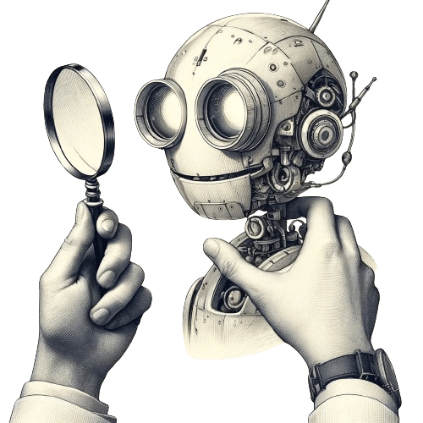

Foundations of Interpretable AI
Tutorial @
PART I: Motivation and Post-hoc Methods (9:00 – 9:45 am) Aditya Chattopadhyay (Amazon)
PART II: Shapley Value Based Methods (9:45 – 10:30 am) Jeremias Sulam (Johns Hopkins)
☕️ Coffee break ☕️ (10:30 – 11 am)
PART III: Interpretable by Design Methods (11 – 11:45 am) René Vidal (Penn)

Slide 3

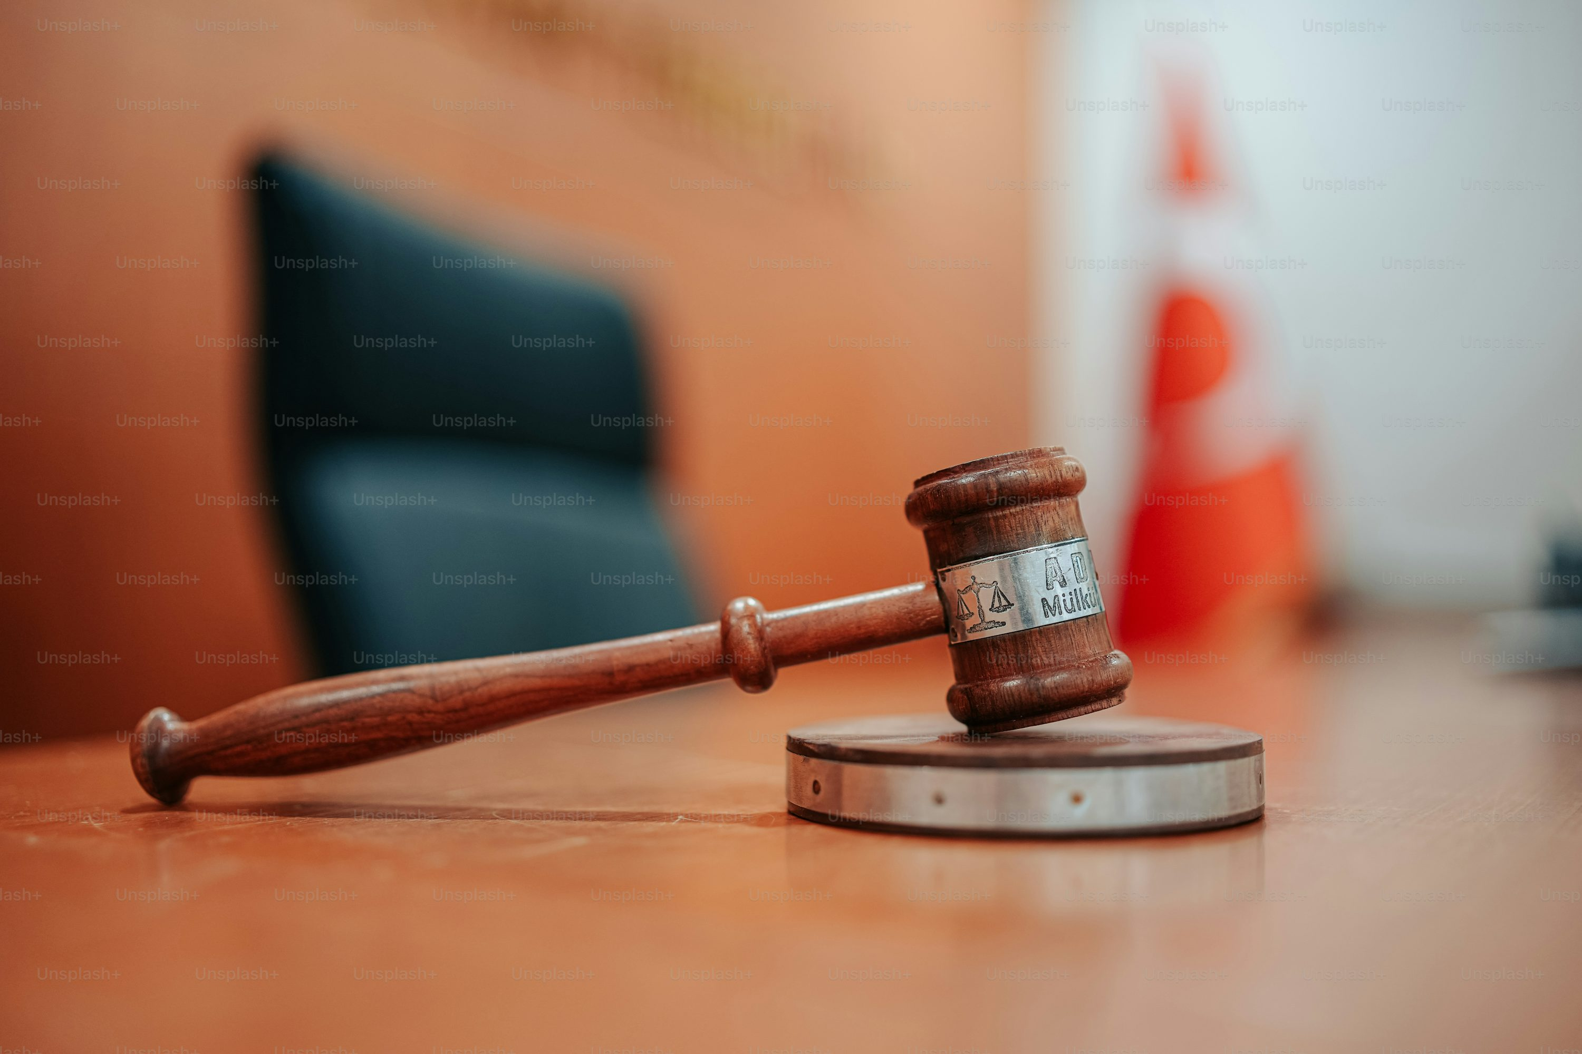


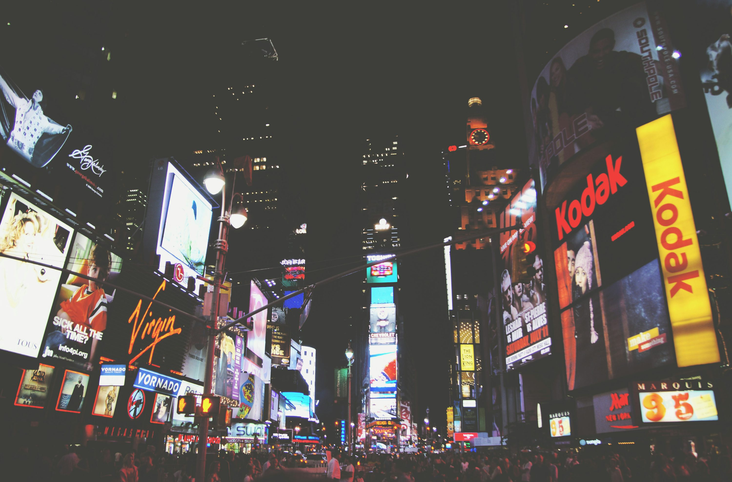

Deep Learning has Become Ubiquitous
Healthcare
Justice System
Credit Approvals
Commerce
Advertisements
Customer Service

Slide 4

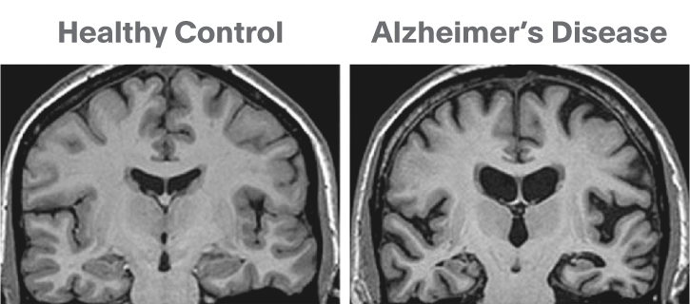
Interpretability Crisis
As deep learning is widely used in safety critical applications, there is a need for developing trustworthy and interpretable models.
Ideally we desire...
But in reality
“Since there is atrophy in this region…”
Patient has Alzheimer’s disease with 98.6% probability
MRI Scan
White-Box
Patient has Alzheimer’s disease with 98.6% probability
MRI Scan
Black-Box

Slide 5
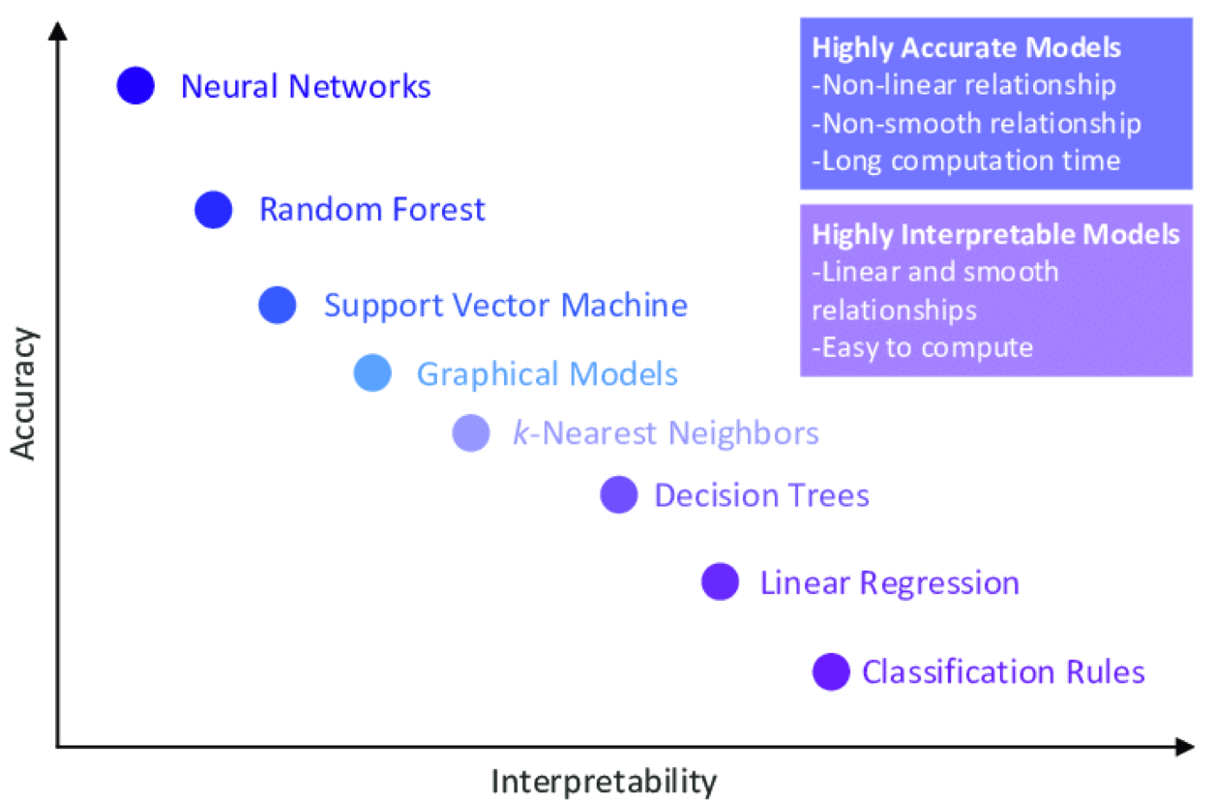
Accuracy vs Interpretability Tradeoff

Slide 6
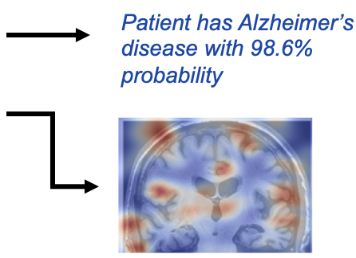
Main Trend: Post-hoc Explanations
Most method interpret black-box models post-hoc using importance scores based on the sensitivity of the model output to the input features:
LIME [1]
Grad-CAM [2]
SHAP [3]
The Good:
No need to retrain model, accuracy maintained.
The Bad:
Explanations are unreliable; not faithful to the model it tries to explain [4].
Feature importance scores might not be interpretable to end-users [5].
MRI Scan
Black-Box
[1] Ribeiro, Singh, Guestrin. "Why Should I Trust You?” Explaining the Predictions of Any Classifier. KDD, 2016.
[2] Selvaraju, Cogswell, Das, Vedantam, Parikh, Batra. Grad-CAM: Visual Explanations from Deep Networks via Gradient-based Localization. ICCV 2017.
[3] Lundberg and Su-In Lee. A Unified Approach to Interpreting Model Predictions. NIPS, pp 4765–4774, 2017.
[4] Adebayo, J., Gilmer, J., Muelly, M., Goodfellow, I., Hardt, M., & Kim, B. Sanity checks for saliency maps. NeurIPS, 2018
[5] Rudin. Stop explaining black box machine learning models for high stakes decisions and use interpretable models instead. Nature Machine Intelligence, 2019.

Slide 7
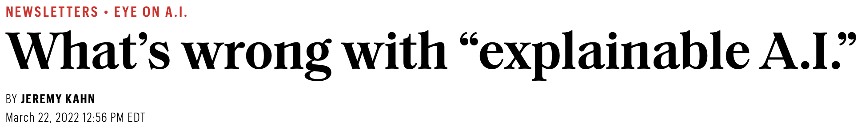
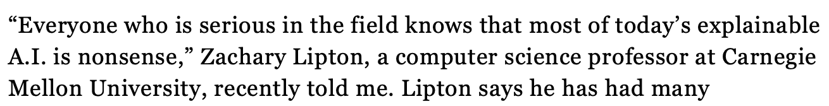
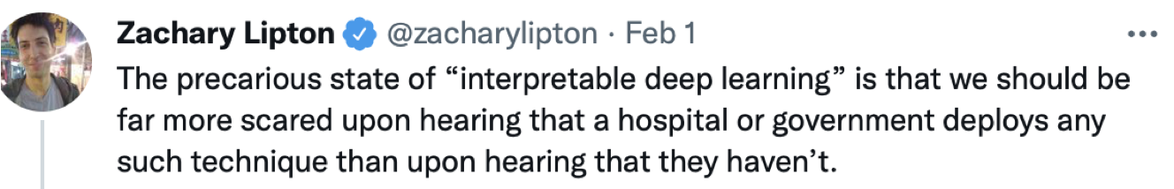
What’s Wrong with Explainable AI?

Slide 8
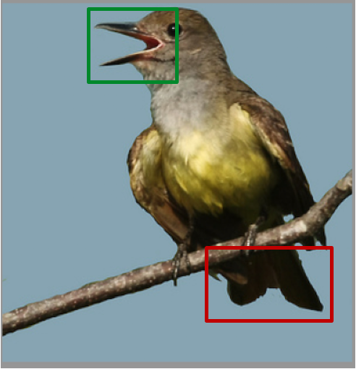
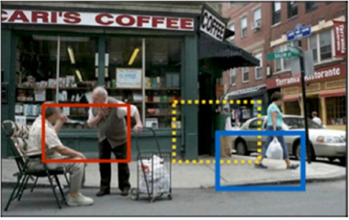
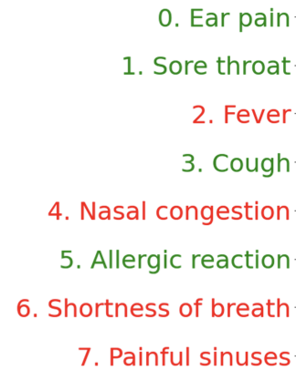
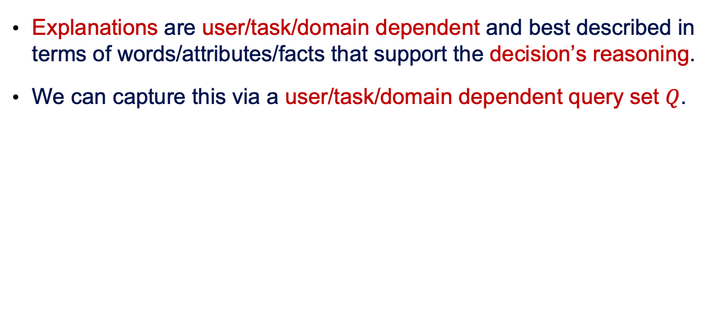
Need for Interpretable-by-Design Models
Explanations are user/task/domain dependent and best described in terms of words/attributes/facts that support the decision’s reasoning.
We can capture this via a user/task/domain dependent query set $Q$.
(a)
Task: bird classification
Queries: parts, attributes
(b)
Task: scene interpretation
Queries: objects, relationships
(c)
Task: medical diagnosis
Queries: symptoms

Slide 9
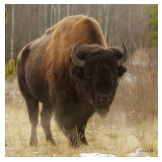
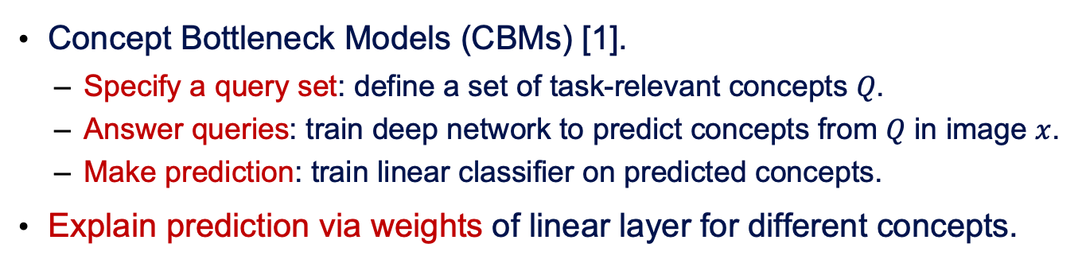
Concept Bottleneck Models (CMBs)
Has Horns? Yes
Has Fur? Yes
Has Wings? No
Is Four-legged? Yes
.
.
.
Deep Network
Linear Network
Bison
Input
Concept Predictor
Classifier
Prediction
Concept Bottleneck Models (CBMs) [1].
Specify a query set: define a set of task-relevant concepts 𝑄.
Answer queries: train deep network to predict concepts from 𝑄 in image $x$.
Make prediction: train linear classifier on predicted concepts.
Explain prediction via weights of linear layer for different concepts.
[1] Koh, P. W., Nguyen, T., Tang, Y. S., Mussmann, S., Pierson, E., Kim, B., & Liang, P. Concept bottleneck models. ICML, 2020.

Slide 10
Are Concept Bottleneck Models Enough?
Has Horns? Yes
Has Fur? Yes
Has Wings? No
Is Four-legged? Yes
.
.
.
Deep Network
Linear Network
Bison
Input
Concept Predictor
Classifier
Prediction
Limited expressivity: linear classification layer limits expressivity of CBMs when “concept answers → class prediction” map is non-linear.
Limited interpretability: explanations in terms of coefficients of linear weights not always desirable to end-users, especially non-AI experts.
Limited flexibility: same explanations for all inputs in the same class.

Slide 11
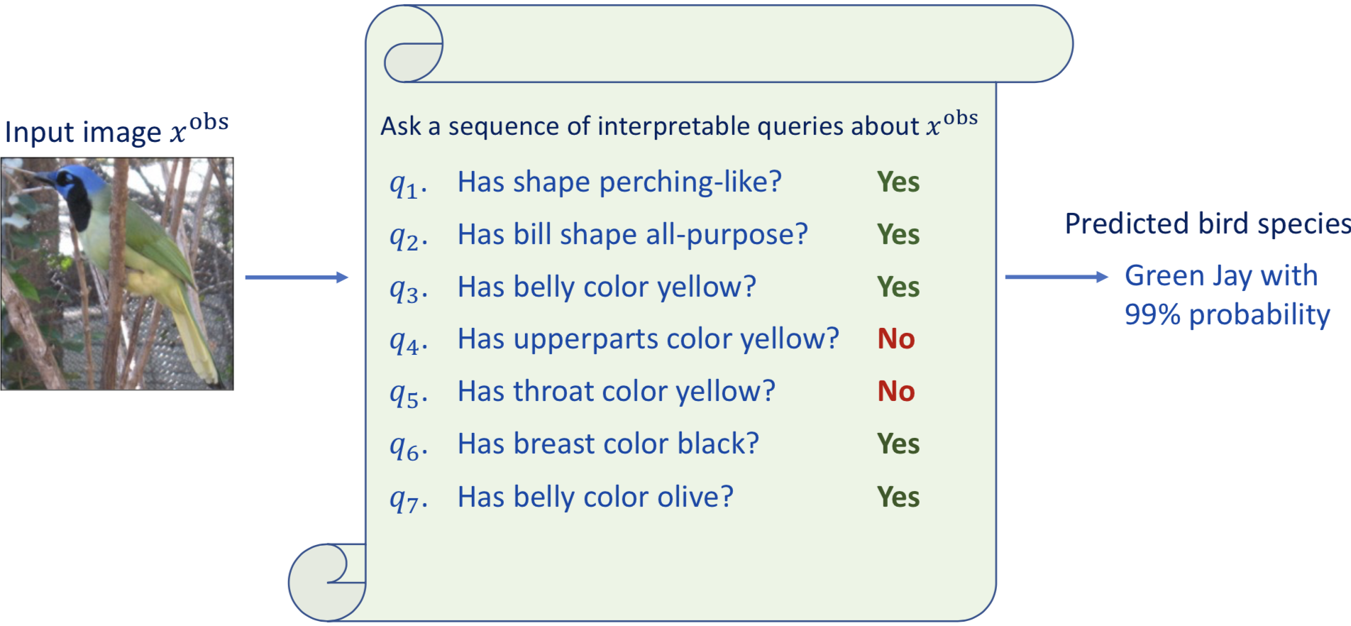
Information Pursuit Framework
Information Pursuit: interpretable-by-design framework based on:
Selecting the smallest number of queries that are sufficient for prediction.
Making a prediction based only on the chain of query-answer pairs.
[1] Chattopadhyay, Slocum, Haeffele, Vidal, Geman. Interpretable by design: Learning predictors by composing interpretable queries. TPAMI 2022.

Slide 12
Ingredients Needed to Implement this Framework
Q1: How do we define the set of queries?
Defined by domain experts [1].
Defined by large language models [4].
Q2: Given an input and a query, how do we answer the query?
Train classifiers on data annotated with query answers by task experts [1].
Use domain-specific pre-trained large vision language models [4].
Q3: How do we select queries that form the explanation?
Information Pursuit: Select smallest number of queries that are sufficient for prediction using Generative IP [1], Variational IP [2], and OMP [3].
[1] Chattopadhyay, Slocum, Haeffele, Vidal, Geman. Interpretable by design: Learning predictors by composing interpretable queries. TPAMI 2022. [2] Chattopadhyay, Chan, Haeffele, Geman, Vidal. Variational Information Pursuit for Interpretable Predictions, ICLR 2023.
[3] Chattopadhyay, Pilgrim, Vidal. Information Maximization Perspective of Orthogonal Matching Pursuit with Applications to Explainable AI. NeurIPS 2023.
[4] Chattopadhyay, Chan, Vidal. Bootstrapping Variational Information Pursuit with Foundation Models for Interpretable Image Classification. ICLR 2024.
[5] Chattopadhyay, Haeffele, Vidal, Geman. Performance Bounds for Active Binary Testing with Information Maximization. ICML 2024.

Slide 13
Q1: How to define the set of queries?

Slide 14
Q1: How do we Define the Set of Queries?
Defined by domain experts [1,2]
Assume queries have similar semantic resolution.
CUB dataset
200+ bird classes
300+ bird attributes
SymCAT-200 dataset
200 disease diagnosis
326 patient symptoms
Challenge
Annotating queries is very costly
(a)
Task: bird classification
Queries: parts, attributes
(c)
Task: medical diagnosis
Queries: symptoms
[1] Koh, P. W., Nguyen, T., Tang, Y. S., Mussmann, S., Pierson, E., Kim, B., & Liang, P. Concept bottleneck models. ICML, 2020.
[2] Chattopadhyay, Slocum, Haeffele, Vidal, Geman. Interpretable by design: Learning predictors by composing interpretable queries. TPAMI 2022.
[3] Oikarinen, T., Das, S., Nguyen, L. M., & Weng, T. W. (2023). Label-free concept bottleneck models. ICLR 2023 [4] Chattopadhyay, Chan, Vidal. Bootstrapping Variational Information Pursuit with Foundation Models for Interpretable Image Classification. ICLR 2024.

Slide 15
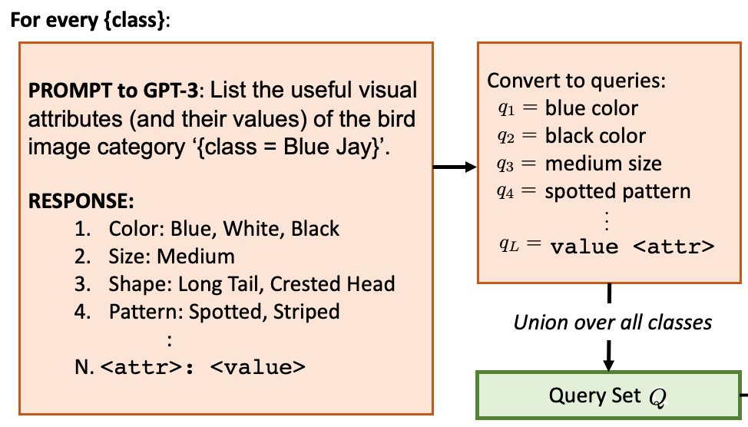
Q1: How do we Define the Set of Queries?
Defined by large language models [3,4].
E.g., ask LLM for list of attributes of all relevant categories.
[1] Koh, P. W., Nguyen, T., Tang, Y. S., Mussmann, S., Pierson, E., Kim, B., & Liang, P. Concept bottleneck models. ICML, 2020.
[2] Chattopadhyay, Slocum, Haeffele, Vidal, Geman. Interpretable by design: Learning predictors by composing interpretable queries. TPAMI 2022.
[3] Oikarinen, T., Das, S., Nguyen, L. M., & Weng, T. W. (2023). Label-free concept bottleneck models. ICLR 2023 [4] Chattopadhyay, Chan, Vidal. Bootstrapping Variational Information Pursuit with Foundation Models for Interpretable Image Classification. ICLR 2024.

Slide 16
Q2: Given an input and a query, how do we answer the query?

Slide 17
Q2: How do we Answer a Query for a given Input?
Train classifiers on data annotated with query answers [1].
Challenge: need tons of data annotated with all concepts/attributes/facts => few datasets have such detailed annotations.
Challenge: cannot handle new queries that have not been annotated.
Has Horns? Yes
Has Fur? Yes
Has Wings? No
Is Four-legged? Yes
.
.
.
Deep Network
Input
Concept Predictor
[1] Koh, P. W., Nguyen, T., Tang, Y. S., Mussmann, S., Pierson, E., Kim, B., & Liang, P. Concept bottleneck models. ICML, 2020.

Slide 18
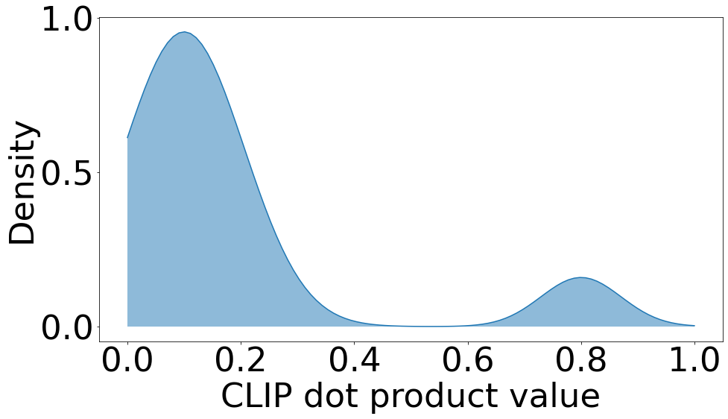
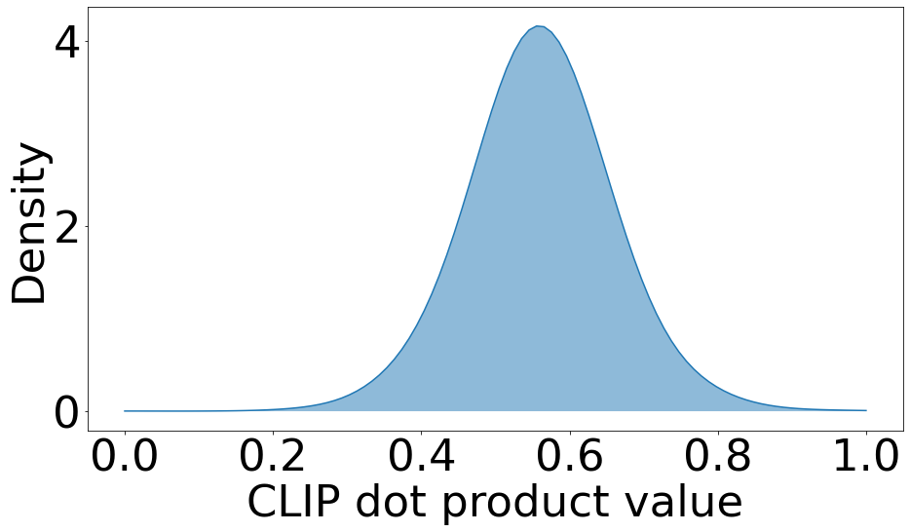
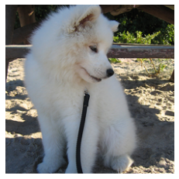

Q2: How do we Answer a Query for a given Input?
Use Vision Language Models (VLMs) to answer queries
Challenge: State-of-the-art VLMs like Llama [1] and BLIP [2] are too slow to be used in an online manner.
Challenge: CLIP [3] is relatively light-weight, but CLIP dot products between query and image are inadequate: they are not interpretable.
Desired distribution of CLIP dot products
Observed distribution of CLIP dot products
Threshold
Input image $x^{obs}$
Threshold?
No
Yes
[1] Touvron, Lavril, Izacard, Martinet, Lachaux, Lacroix, Rozière et al. "Llama: Open and efficient foundation language models." arXiv preprint arXiv:2302.13971, 2023. [2] Li, Junnan, et al. "Blip-2: Bootstrapping language-image pre-training with frozen image encoders and large language models." ICML 2023.
[3] Radford, Kim, Hallacy, Ramesh, Goh, Agarwal, Sastry et al. "Learning transferable visual models from natural language supervision." ICML 2021

Slide 19
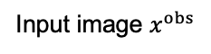
Q2: Can we Improve CLIP without Annotations?
In image classification, most query answers are known to be false based on the class alone.
Example: Know class is dog → “does the subject have fins?” is false → no need to see the image.
We need to look at the image only for queries relevant to the class.
Example: “Does the subject have a leash?”. Need to see image since not all dogs have a leash.
Input image $x^{obs}$
Yes! Use LLMs

Slide 20
Concept Question Answering System [1]
Pseudo-labeling: Use GPT to determine class-relevant queries and use CLIP to determine probability of being true based on image.
Concept-QA: Train a lightweight visual question answering (VQA) system using pseudo-answers as we don’t know class at test time.
[1] Chattopadhyay, Chan, Vidal. "Bootstrapping Variational Information Pursuit with Foundation Models for Interpretable Image Classification." ICLR 2024

Slide 21
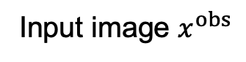
Interpretability of Concept-QA answers
Concept-QA is more interpretable than CLIP!
Input image $x^{obs}$

Slide 22
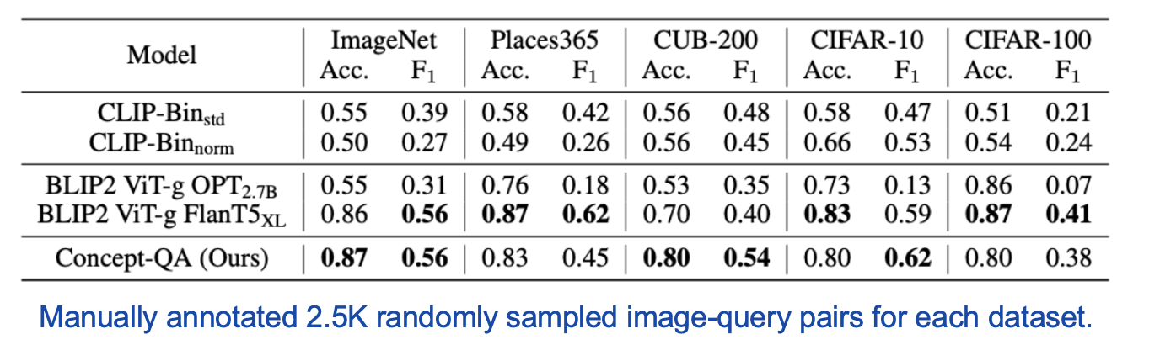
Accuracy of Concept-QA answers
Concept-QA is more accurate than CLIP & more efficient than BLIP2:
Concept-QA takes 0.04s per query vs 1.52s per query for BLIP2 FlanT5 model!

Slide 23
Q3: How do we select the queries that form an explanation?

Slide 24
Information Pursuit (IP)
Q3: How do we select queries that form the explanation?
Shorter chains are easier to interpret.
Select smallest number of queries that are sufficient for prediction.
Generative-IP (G-IP) [1]
Variational-IP (V-IP) [2]
Learn deep generative model and use it to select most informative queries.
Train deep network to select the next optimal query given answers thus far.
IP-OMP [3]
Use orthogonal matching pursuit and large vision and language models.
[1] Chattopadhyay, Slocum, Haeffele, Vidal, Geman. Interpretable by design: Learning predictors by composing interpretable queries. TPAMI 2022. [2] Chattopadhyay, Chan, Haeffele, Geman, Vidal. Variational Information Pursuit for Interpretable Predictions, ICLR 2023.
[3] Chattopadhyay, Pilgrim, Vidal. Information Maximization Perspective of Orthogonal Matching Pursuit with Applications to Explainable AI. NeurIPS 2023.
[4] Chattopadhyay, Chan, Vidal. Bootstrapping Variational Information Pursuit with Foundation Models for Interpretable Image Classification. ICLR 2024.
[5] Chattopadhyay, Haeffele, Vidal, Geman. Performance Bounds for Active Binary Testing with Information Maximization. ICML 2024.

Slide 25
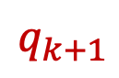


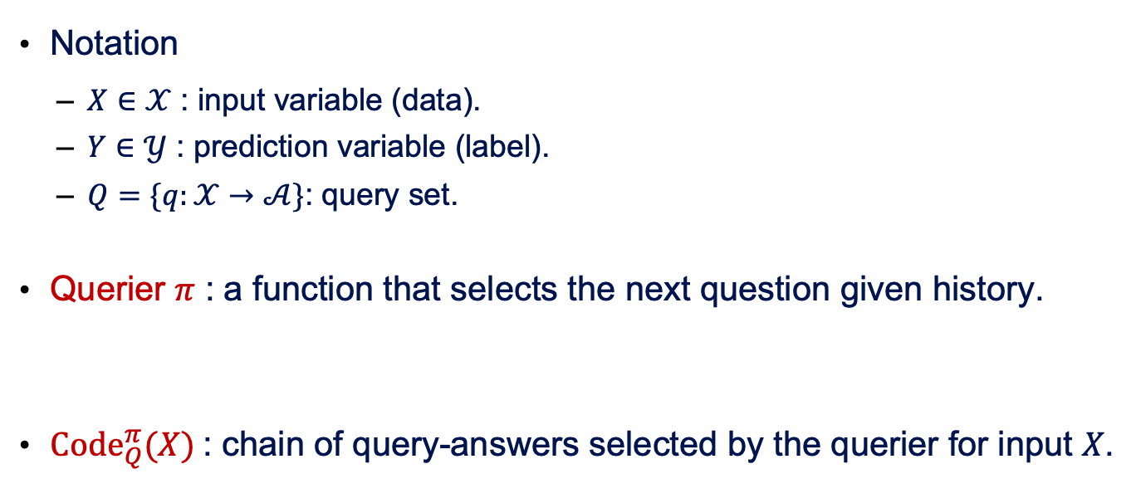
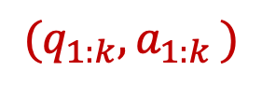


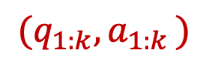
Information Pursuit: Problem Formulation
Notation
$X∈𝒳$ : input variable (data).
$Y∈𝒴$ : prediction variable (label).
$Q=\{q:𝒳→𝒜\}$: query set.
Querier 𝜋 : a function that selects the next question given history.
${Code}_{Q}^{π}(X)$: chain of query-answers selected by the querier for input 𝑋.
$$X$$
$$q$$
$$a$$
$${(q}_{1:k}{, a}_{1:k})$$
$$π$$
$$q_{k+1}$$
$${(q}_{1:k}{, a}_{1:k})$$

Slide 26
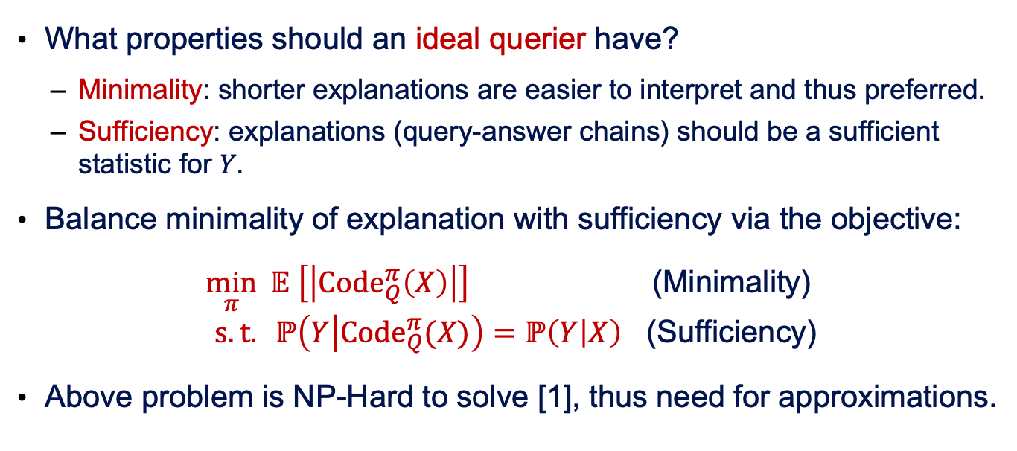
Information Pursuit: Optimal Querier
What properties should an ideal querier have?
Minimality: shorter explanations are easier to interpret and thus preferred.
Sufficiency: explanations (query-answer chains) should be a sufficient statistic for 𝑌.
Balance minimality of explanation with sufficiency via the objective:
$\min_{π} 𝔼 \left[\left|{Code}_{Q}^{π}\left(X\right)\right|\right]$ (Minimality) $s.t. ℙ\left(Y | {Code}_{Q}^{π}(X)\right)=ℙ\left(Y | X\right)$ (Sufficiency)
Above problem is NP-Hard to solve [1], thus need for approximations.
[1] H. Laurent and R. L. Rivest, "Constructing optimal binary decision trees is np-complete", Inf. Process. Lett., vol. 5, no. 1, pp. 15-17, 1976.

Slide 27
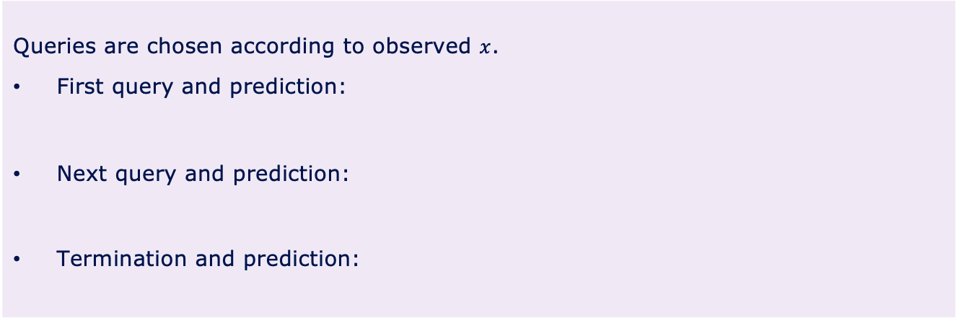
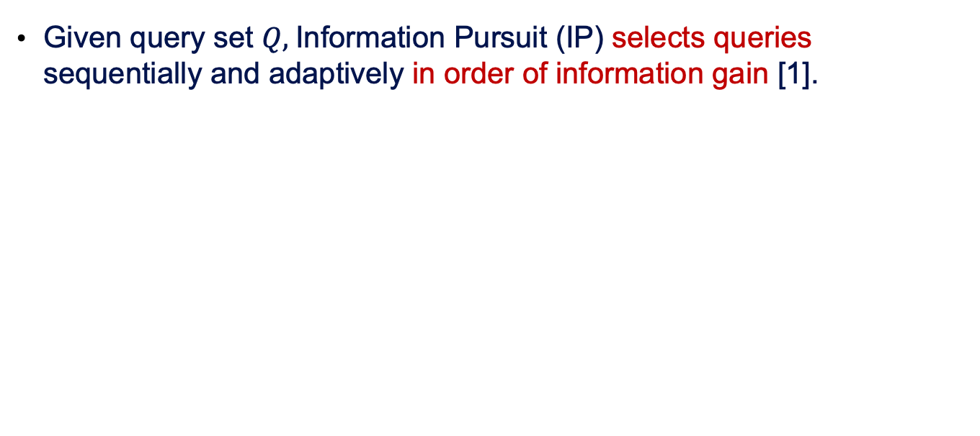
Generative Information Pursuit (G-IP)
Given query set $Q,$Information Pursuit (IP) selects queries sequentially and adaptively in order of information gain [1].
Information Pursuit Algorithm
Queries are chosen according to observed $x$.
First query and prediction:
Next query and prediction:
Termination and prediction:
is the event that contains all realizations of $X$ that agree on the first $k$ query-answers for $x$.
[1] Geman and Jedynak, An active testing model for tracking roads from satellite images, TPAMI, 1996.

Slide 28
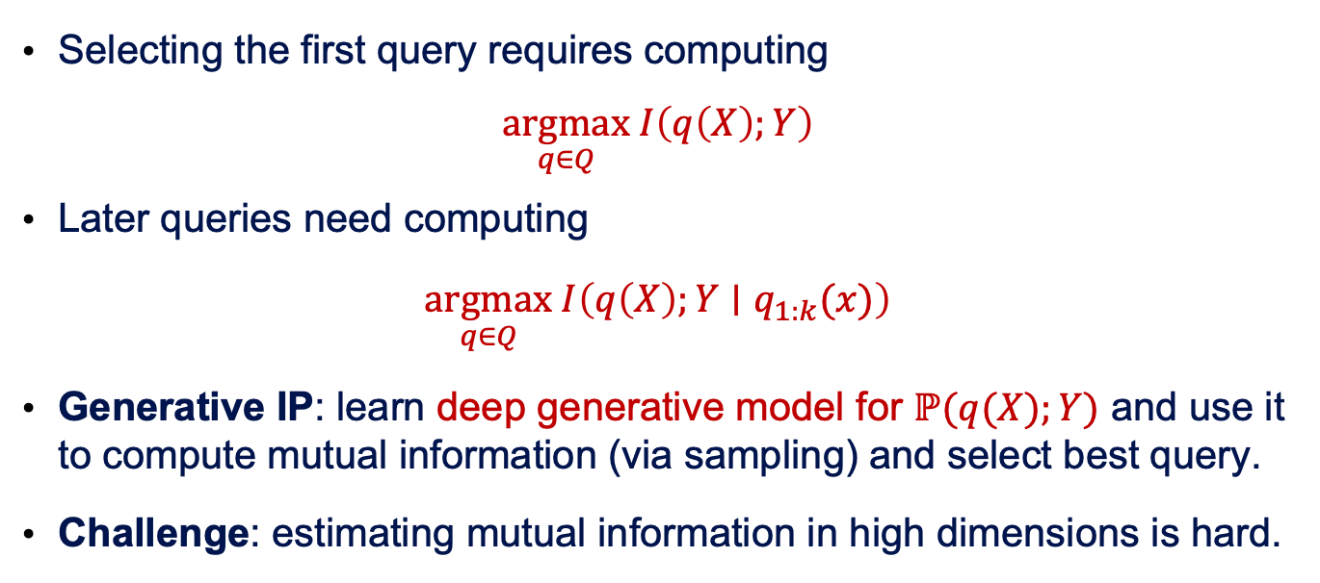
Generative Information Pursuit (G-IP)
Selecting the first query requires computing
$$\underset{q∈Q}{argmax} I\left(q\left(X\right);Y\right)$$
Later queries need computing
$$\underset{q∈Q}{argmax} I\left(q\left(X\right);Y∣q_{1:k}(x)\right)$$
Generative IP: learn deep generative model for $ℙ(q(X);Y)$ and use it to compute mutual information (via sampling) and select best query.
Challenge: estimating mutual information in high dimensions is hard.
History
[1] Chattopadhyay, Slocum, Haeffele, Vidal, Geman. (2022). Interpretable by design: Learning predictors by composing interpretable queries. TPAMI 2022.

Slide 29
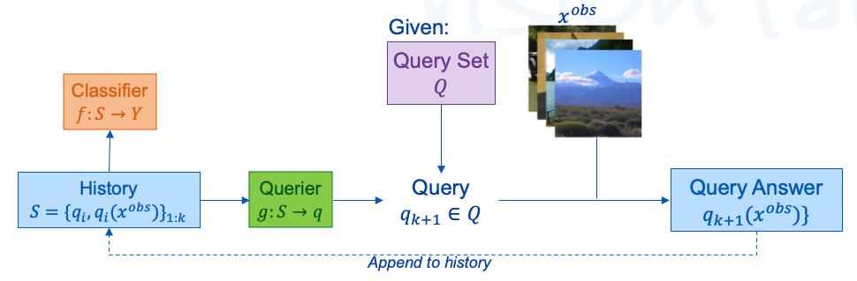
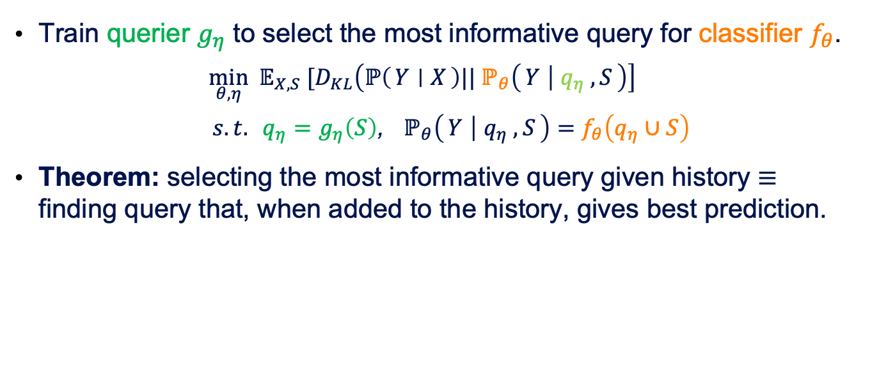
Variational Information Pursuit (V-IP)
Train querier $g_{η}$ to select the most informative query for classifier $f_{θ}$.
$$\min_{θ,η} 𝔼_{X,S} [D_{KL}\left(ℙ\left(Y ∣ X\right)|| ℙ_{θ}\left(Y ∣ q_{η} ,S\right)\right]$$
$s.t. {q_{η}=g}_{η}\left(S\right)$, $ℙ_{θ}\left(Y ∣ q_{η} ,S\right)=f_{θ}\left(q_{η}∪S\right)$
Theorem: selecting the most informative query given history $≡$ finding query that, when added to the history, gives best prediction.
[2] Chattopadhyay, Chan, Haeffele, Geman, Vidal. Variational Information Pursuit for Interpretable Predictions, ICLR 2023.

Slide 30
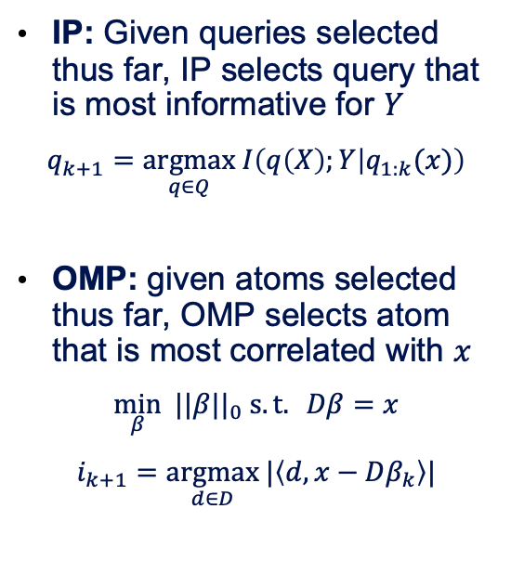
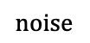
IP vs Orthogonal Matching Pursuit (OMP)
IP: Given queries selected thus far, IP selects query that is most informative for $Y$
$$q_{k+1}=\underset{q∈Q}{argmax} I\left(q\left(X\right);Y | q_{1:k}(x)\right)$$
OMP: given atoms selected thus far, OMP selects atom that is most correlated with $x$
$$\min_{β} ||β||_{0} s.t. Dβ=x$$
$$i_{k+1}=\underset{d∈D}{argmax} |\left\langle d, x−Dβ_{k}\right\rangle |$$
CLIP-IP-OMP [1]: decompose image as sparse linear combination of semantic dictionary
$$noise$$
Image credit: https://en.wiktionary.org/wiki/cat#/media/File:Cat03.jpg
[1] Chattopadhyay, Pilgrim, Vidal. Information Maximization Perspective of Orthogonal Matching Pursuit with Applications to Explainable AI. NeurIPS 2023.

Slide 31
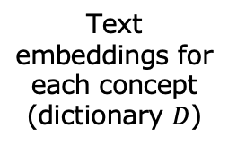
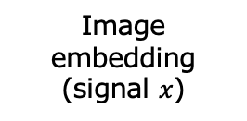
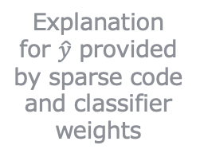
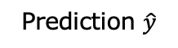

CLIP-IP-OMP: Details
Input image
Text concepts
CLIP Image Encoder
CLIP Text Encoder
Image embedding (signal $x$)
Text embeddings for each concept
(dictionary $D$)
IP-OMP
Sparse code $\hat{β}$ for image in terms of concepts
Explanation for $\hat{y}$ provided by sparse code and classifier weights
Classifier
Learned classifier weights
Prediction $\hat{y}$
[1] Chattopadhyay, Pilgrim, Vidal. Information Maximization Perspective of Orthogonal Matching Pursuit with Applications to Explainable AI. NeurIPS 2023.

Slide 32
Summary of the Information Pursuit Framework
Q1: How do we define the set of queries?
Defined by domain experts [1].
Defined by large language models [4].
Q2: Given an input and a query, how do we answer the query?
Train classifiers on data annotated with query answers by task experts [1].
Use domain-specific pre-trained large vision language models [4].
Q3: How do we select queries that form the explanation?
Information Pursuit: Select smallest number of queries that are sufficient for prediction using Generative IP [1], Variational IP [2], and OMP [3].
[1] Chattopadhyay, Slocum, Haeffele, Vidal, Geman. Interpretable by design: Learning predictors by composing interpretable queries. TPAMI 2022. [2] Chattopadhyay, Chan, Haeffele, Geman, Vidal. Variational Information Pursuit for Interpretable Predictions, ICLR 2023.
[3] Chattopadhyay, Pilgrim, Vidal. Information Maximization Perspective of Orthogonal Matching Pursuit with Applications to Explainable AI. NeurIPS 2023.
[4] Chattopadhyay, Chan, Vidal. Bootstrapping Variational Information Pursuit with Foundation Models for Interpretable Image Classification. ICLR 2024.
[5] Chattopadhyay, Haeffele, Vidal, Geman. Performance Bounds for Active Binary Testing with Information Maximization. ICML 2024.

Slide 33
Applications

Slide 34
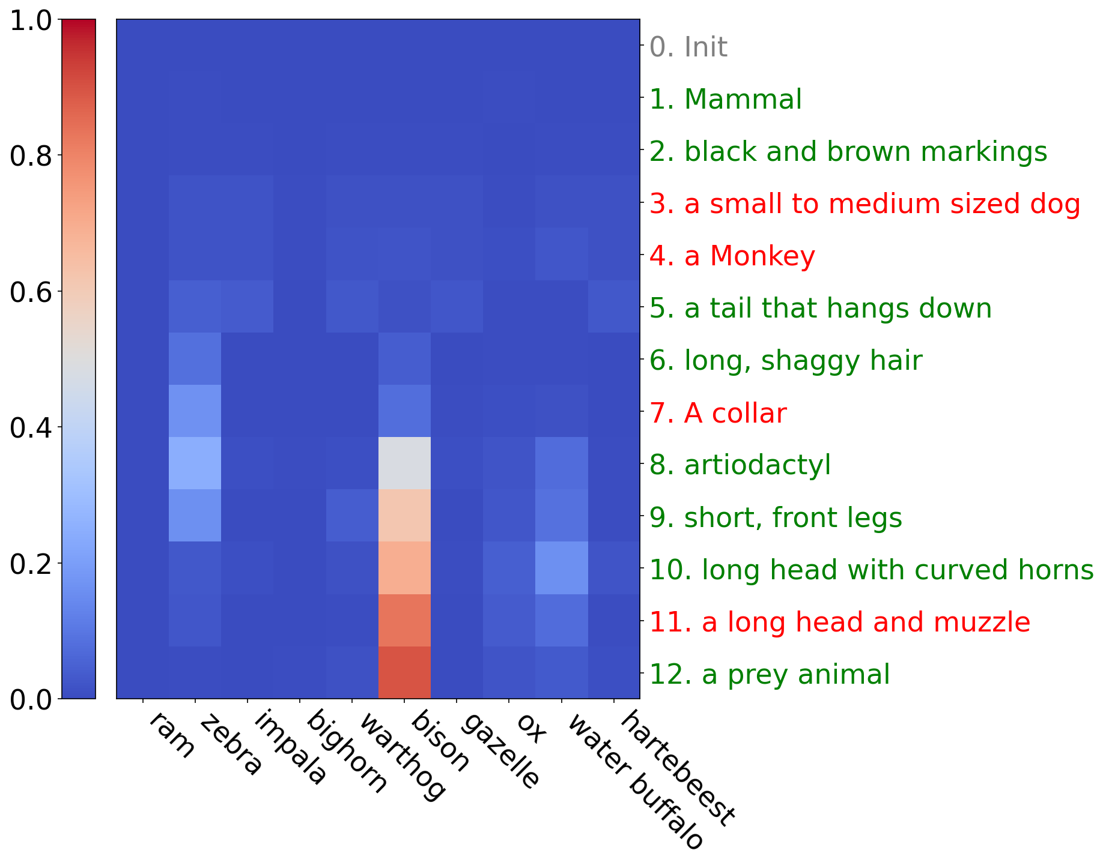
Interpretable Image Classification by V-IP
Task: Image classification.
Query set: Queries about presence or absence of different semantic concepts.
Dataset: ImageNet
1000 classes
Notes:
I have a sequence of slides below giving the whole trajectory if time permits, but I think this is ok given we are already talking a bit about the sequence in illustrative example on slide 8.

Slide 35
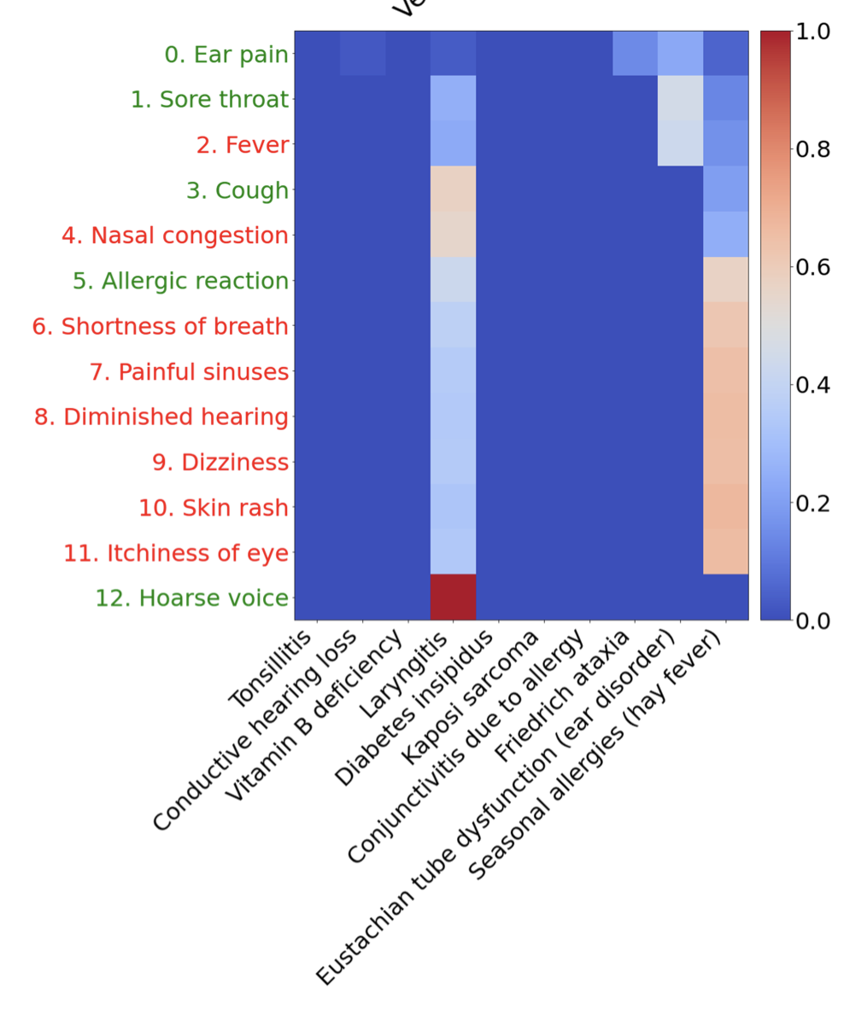
Interpretable Medical Diagnosis by VI-P
Task: Disease diagnosis.
Query set: Queries about presence or absence of different symptoms.
Dataset: SymCAT-200
1.1M doctor-patient dialogues about 326 symptoms indicative of 200 diseases.
Each dialogue: 2-3 symptoms per patient.
326 binary queries, one per symptom.
Notes:
I have a sequence of slides below giving the whole trajectory if time permits, but I think this is ok given we are already talking a bit about the sequence in illustrative example on slide 8.

Slide 36
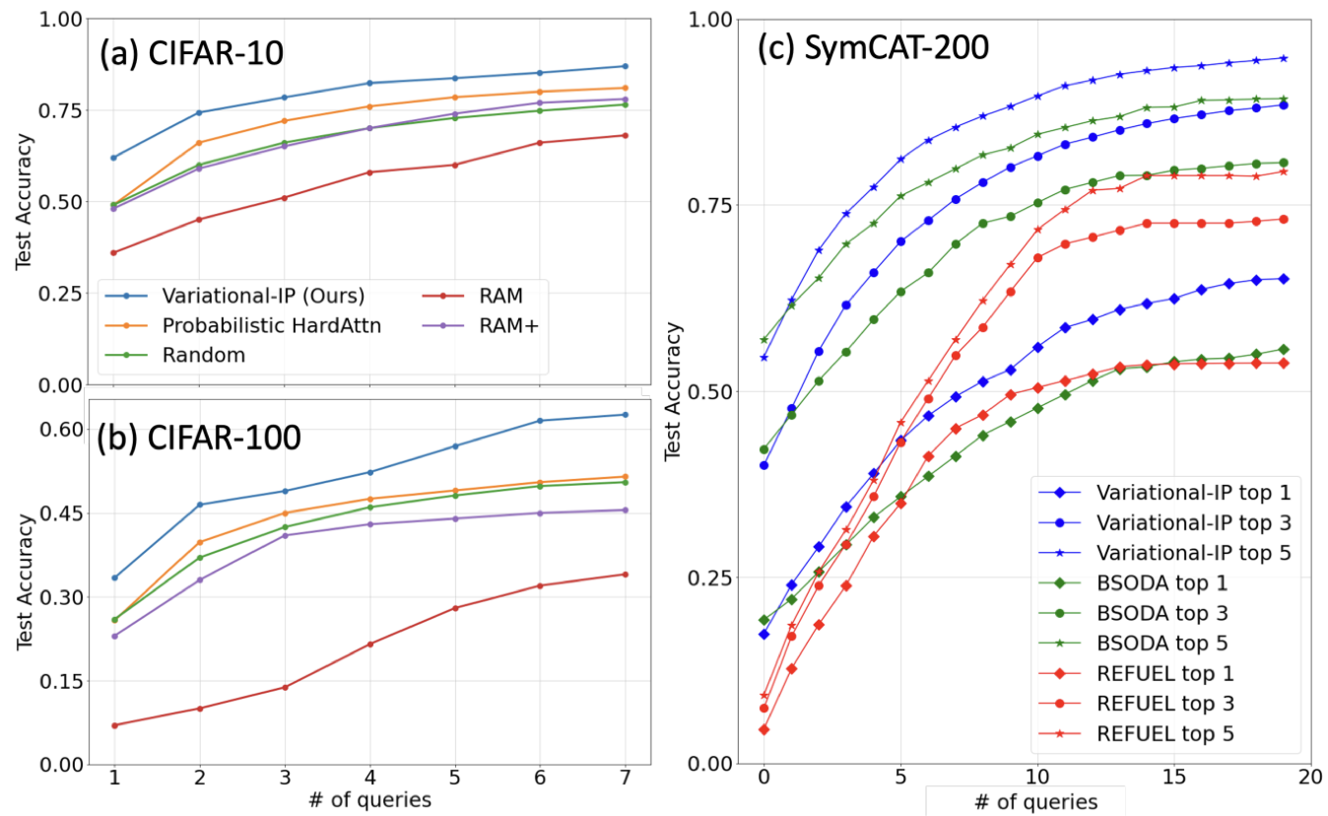
Accuracy Versus Number of Queries

Slide 37
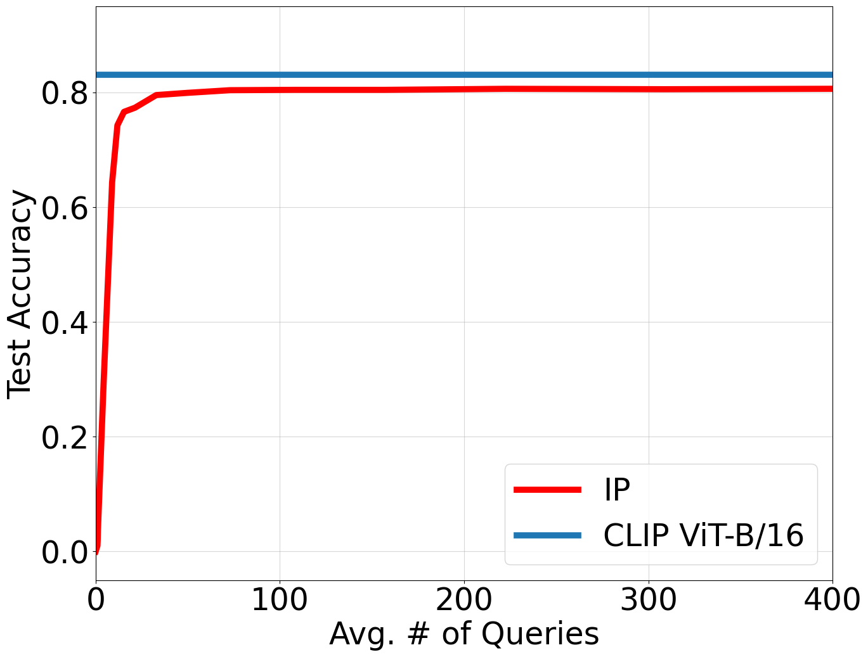
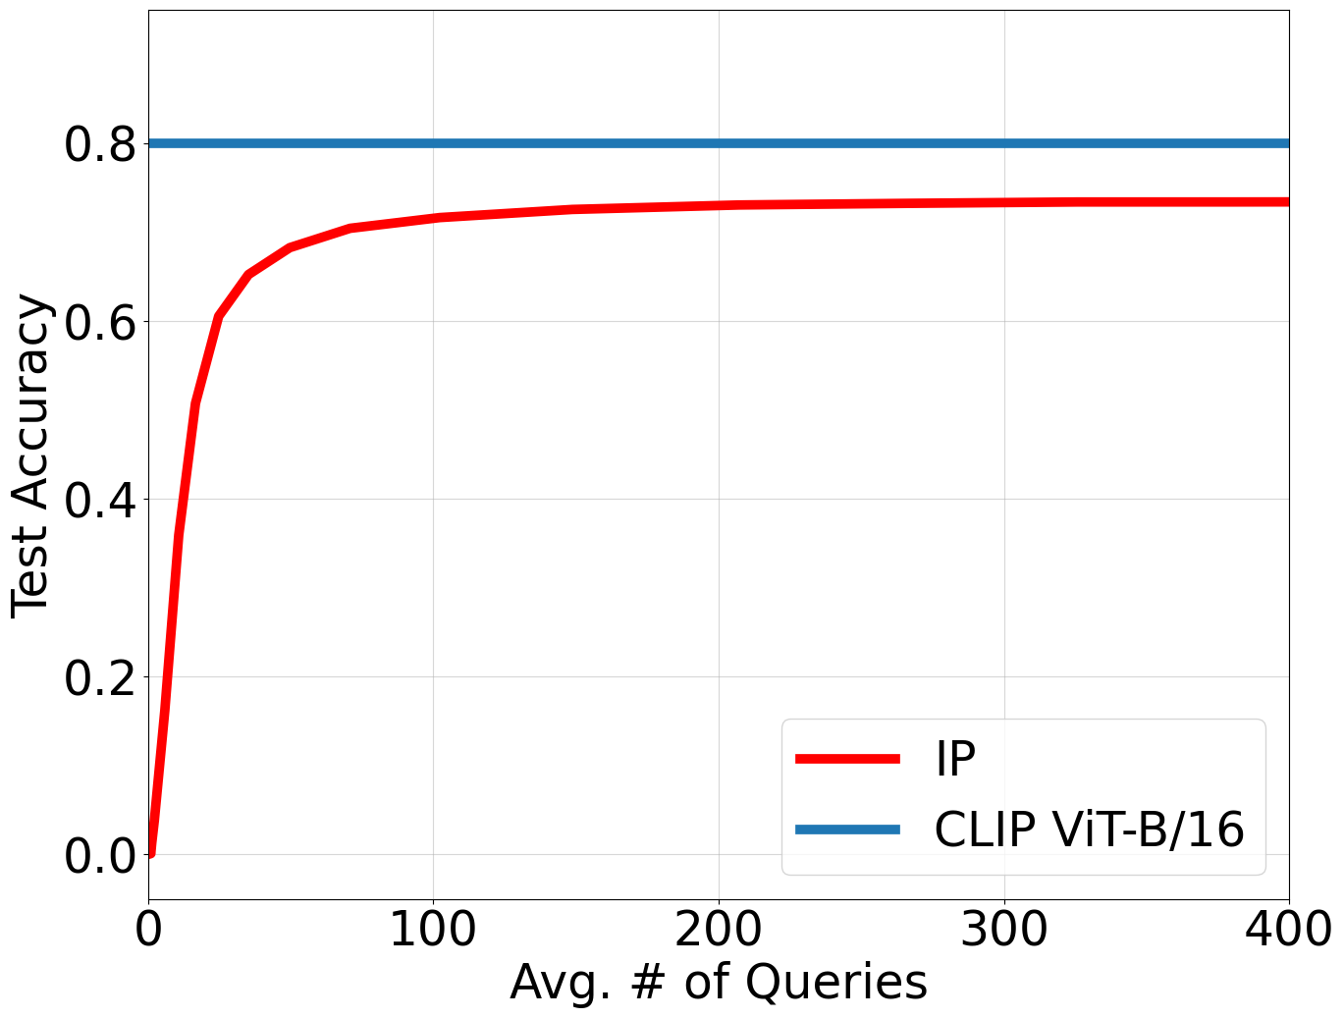
Accuracy-Explainability Tradeoff
How far is interpretable-by-design from black-box model performance
CIFAR-100
Accuracy Gap
ImageNet
Accuracy Gap

Slide 38
Interpretable Radiological Report Classification
Task: Predict disease label in a radiological report.
Query set: Queries about presence or absence of facts in a radiology report.
Dataset: MIMIC-CXR
Data: 227,827 reports.
Queries are binary questions, one for each possible fact.
The task is to predict the disease label.

Slide 39
Interpretable Radiological Report Classification
Q1: How do we define the set of queries?
Leverage LLMs and medical knowledge to extract 591,920 facts from 227,827 reports in the MIMIC-CXR dataset [1].
Q2: How do we answer a query for a given input?
Leverage LLMs and medical knowledge to verify if a fact is present in a radiology report [2].
Q3: How do we select the best queries to form an explanation?
Select smallest number of facts that are sufficient for disease prediction [2] using Variational IP [3,4].
[1] Messina, Vidal, Parra, Soto, Araujo. Extracting and Encoding: Leveraging LLMs and Medical Knowledge to Enhance Radiological Text Representation. ACL 2024.
[2] Ge, Chan, Messina, Vidal. Information Pursuit for Interpretable Classification of Chest Radiology Reports. ArXiv 2025.
[3] Chattopadhyay, Chan, Haeffele, Geman, Vidal. Variational Information Pursuit for Interpretable Predictions. ICLR 2023.
[4] Chattopadhyay, Chan, Vidal. Bootstrapping Variational Information Pursuit with Foundation Models for Interpretable Image Classification. ICLR 2024.

Slide 40
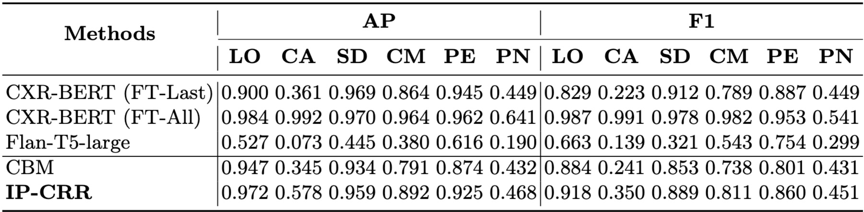
Interpretable Radiological Report Classification
Average precision (AP) and F1 score of IP-CRR on six binary prediction tasks:
Lung Opacity (LO), Calcification of the Aorta (CA), Support Devices(SD),
Cardiomegaly(CM), Pleural Effusion(PE), and Pneumonia(PN).

Slide 41
Summary
Information Pursuit: an interpretable-by-design prediction framework.
Generative model: use LLMs to define queries, VLMs to answer queries, and G-IP, V-IP, OMP to select queries and make predictions.

Slide 42
Open Questions
How to learn the queries?
Augment VIP with dictionary learning technique to learn queries.
How to extend framework beyond classification?
Integrate VIP with diffusion models for explainable generations [ICLR’25].
How to extend sparse representation theory for interpretable AI?
New notions of incoherence, RIP based on mutual information?
Is uniqueness of sparse codes related to uniqueness of explanations?
Extensions of sparse coding to semantic dictionaries via LLMs?

Slide 43
Open Questions
How to define interpretability?
Hypothesis tests on the importance of a feature?
Minimum set of interpretable features that are sufficient for prediction?
What about causality-based explanations?
How to evaluate if a model is interpretable?
Human evaluations?
Can humans predict a class based on explanation?
Benchmarks

Slide 44
Thank you

